Slide 1


QUEUE

Slide 2
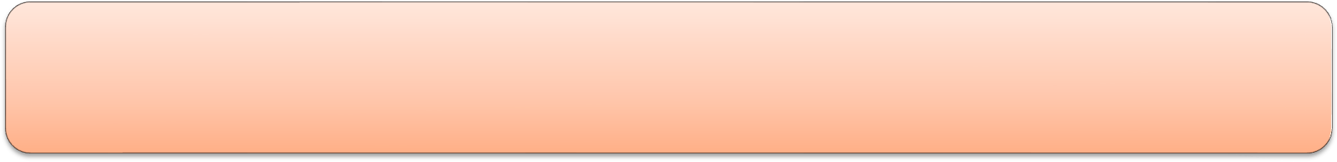
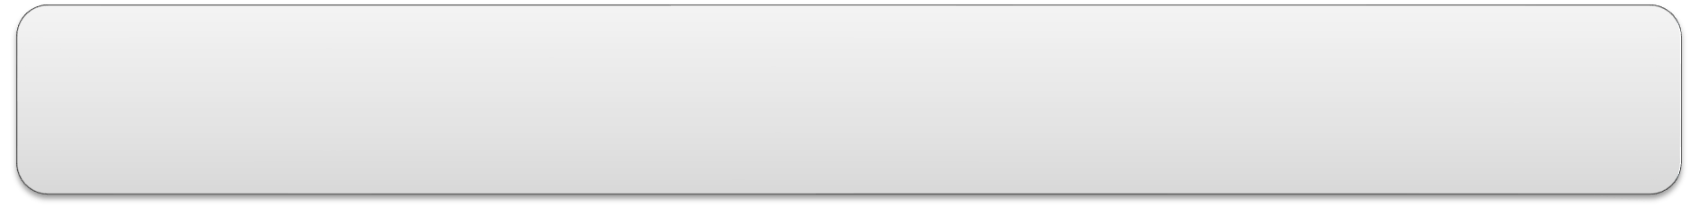

Queue
A queue is simply a waiting line that grows by adding elements to its end and shrinks by taking elements from its front.
A queue is a FIFO structure: first in/first out.

Slide 3
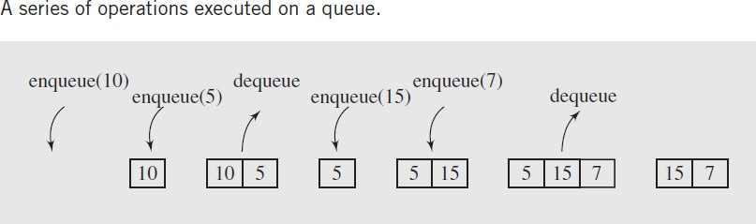
Queue Operations
■ clear()—Clear the queue.
■ isEmpty()—Check to see if the queue is empty.
■ enqueue(el)—Put the element el at the end of the queue.
■ dequeue()—Take the first element from the queue.
■ first()—Return the first element in the queue without removing it.

Slide 4
QUEUE using Link List
Design a Queue class so that following functions are efficient
enqueue(el)—Put the element at the end of the queue.
dequeue()—Take the first element from the queue.
What will you use
SLL
DLL
CLL
head
tail
8
10
12
∅

Slide 5
QUEUE using Linked List
In the singly linked list implementation of Queue,
dequeuing requires O(n) operations if tail pointer is not kept.
With tail point dequeue in single link list will take O(1) time
Queue can be implementation using doubly linked list.
The enqueuing and dequeuing can be done in constant time
O(1)

Slide 6
QUEUE using Arrays
First
last
Can we use Arrays to implement Queue class?
Not a best choice …why ?
Elements are added to the end of the queue, but they may be removed from its beginning, thereby releasing array cells.
These cells should not be wasted.
They should be utilized to enqueue new elements.
 |  | 3 | 4 | 5 | 8

Slide 7

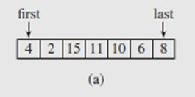

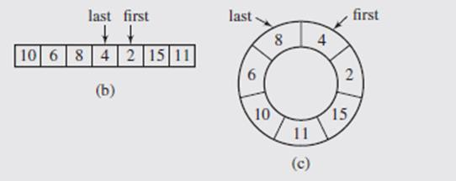
QUEUE using Circular Array
Picture Queue as a circular array
The queue is full if either the first element is in
the first cell and the last element is in the last cell or
if the first element is right after the last
Or keep current size of the queue

Slide 8


Queue using Circular Array
template <class T> class Queue { public:
Queue() {};
bool | enqueue(int | e1);
bool | dequeue(int | &e1);
bool | isFull();
bool | isEmpty();
3
private:
int first; int last;
const int MaxSize int CurrentSize; T array[MaxSize];
2
1
MaxSize-1
0
First
};
Last

Slide 9

Queue using Circular Array
3
2
1
MaxSize-1
0
bool Queue::enqueue(int e1) { if (!isFull()) {
last++;
if (last == MaxSize)
last = 0; QueueArray[last] = e1; if (CurrentSize == 0)
first = last; CurrentSize++; return true;
last = (last+ 1) % MaxSize;
}
else return false;
}

Slide 10
3
first = (first + 1) % MaxSize;
2
1
MaxSize-1
0
Queue using Circular Array
bool Queue::dequeue(int &e1) { if (!isEmpty()) {
e1 = QueueArray[first];
first++;
if (first == MaxSize)
first = 0;
CurrentSize--;
if (CurrentSize == 0)
first = last = -1; return true;
}
else return false;
}
Page:10 QUEUE

Slide 11
Queue
using Circular Array
3
2
1
MaxSize-1
0
bool Queue::enqueue(int e1) { if (!isFull()) {
last++;
if (last == MaxSize)
last = 0; QueueArray[last] = e1; if (CurrentSize == 0)
first = last; CurrentSize++; return true;
}
else return false;
bool Queue::dequeue(int &e1) { if (!isEmpty()) {
e1 = QueueArray[first]; first++;
if (first == MaxSize)
first = 0;
CurrentSize--;
if (CurrentSize == 0)
first = last = -1; return true;
}
else return false;
}
}
Page:11 QUEUE

Slide 12

Queue
What if some one want to leave the Queue ?
How to handle in Array implementation?
(put -1 in the cell to indicate the person has left
How to handle in Link List implementation?
In linked list remove the particular node
Page:13 QUEUE

Slide 13
Priority Queue
Is Linked list a good implementation or array?
Linked List implementation
You can keep linked list sorted
Enqueue will take O(n) time
Dequeue will take O(1) time
You can keep linked list unsorted
Enqueue will take O(1)
Dequeue will take O(n)
Array Implementation
Enqueue will take ?
Dequeue will take ?
Both are not good
Page:14 QUEUE

